Slide 1



Attention-Based Hybrid Precoding for mmWave MIMO Systems
itw2021.org
Kanazawa, Japan, October 17-21
Hao Jiang¹, Yu Lu¹, Xueru Li², Bichai Wang², Yongxing Zhou², and Linglong Dai¹
¹Department of Electronic Engineering, Tsinghua University
²Huawei Technologies Company, Ltd.
2021-10
Notes:
Hello everyone, today I am very glad to introduce our work in ITW. My name is Hao Jiang, comes from Department of Electronic Engineering, Tsinghua University. Today, the title of my speech is Attention-Based Hybrid Precoding for mmWave MIMO Systems. As we all know, hybrid precoding design is a high-complexity problem due to the constant modulus constraint for the analog precoder. Fortunately, the deep learning based hybrid precoding methods can significantly reduce the complexity, but the performance remains limited. In this paper, inspired by the attention mechanism recently developed for machine learning, we will investigate an attention-based hybrid precoding scheme for millimeter-wave (mmWave) MIMO systems.

Slide 2
Contents
1
Technical background
2
Proposed solution
3
Simulation results
4
Conclusions
Notes:
At first, we will introduce the technical background.

Slide 3
mmWave MIMO
Advantages
  High frequency (30-300 GHz): wider bandwidth (20 MHz → 5 GHz)
  Short wavelength: larger antenna array (1~8 → 256~1024)
  High directive transmission: more suitable for small cells
mmWave MIMO
High frequency
Short wavelength
Directive transmission
Wide bandwidth
Large antenna array
Small cell
1000x data rates increase!
Notes:
As we can see from the figure, mmWave MIMO enjoys several advantages. First, the spectrum at mmWave is less crowed and therefore we can provide much wider bandwidth. Second, the large antenna array is easy to arrange in a compact form at mmWave frequencies to achieve high antenna gains. Finally, mmWave MIMO is also appropriate for small-cell as the high directive transmission can avoid multi-cell interferences. As a result, mmWave MIMO is a key technique to achieve significant increase in data rates.

Slide 4

Bottleneck
Challenges
  Traditional fully digital MIMO: one RF chain for one antenna
  Large antenna array → Enormous number of RF chains
  RF chain is energy-intensive at mmWave (300 mW/RF chain)
  High energy consumption is the bottleneck problem
  256 antennas at BS → 76.8 W (only RF chains)
  Micro-cell BS in 4G (baseband + RF + transmit): → less than 10 W
How to reduce the number of RF chains?
Notes:
However, realizing mmWave MIMO is not a trivial task. One challenge is that each antenna in the conventional MIMO systems requires one dedicated RF chain. This will result in unaffordable hardware cost and power consumption in mmWave MIMO, since the number of antennas becomes huge and the power consumption of RF chain is high. (For example, at 60 GHz, one RF chain will consume 300 mW. If we consider a mmWave MIMO base station with 256 antennas, only the RF chains will consume 76.8 Watts. It is much higher than the that of current 4G micro-cell BS). Therefore, how to reduce the number of RF chains will be an urging problem to solve.

Slide 5
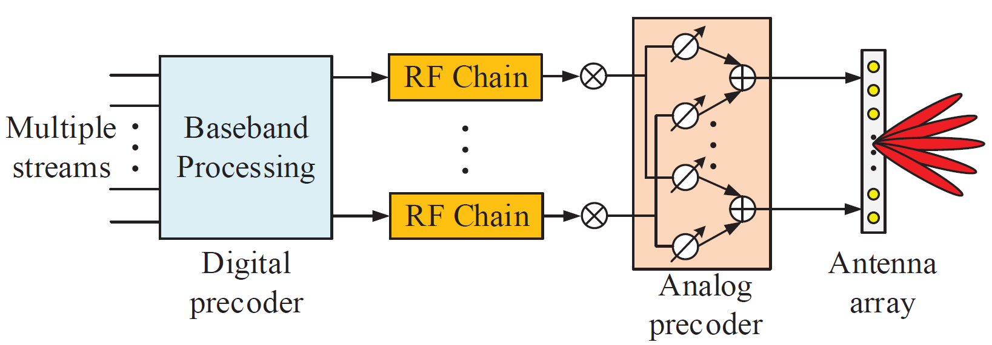

Hybrid precoding mmWave MIMO
Basic idea
  Utilize the low power consumption and cost phase shifts to replace part of the high power consumption and hardware cost RF chains
  Low dimension digital precoder with fewer RF chains
  High dimension analog precoder to achieve array gains
  Jointly design the analog precoder and digital precoder
O. E. Ayach, S. Rajagopal, S. Abu-Surra, Z. Pi, and R. W. Heath, “Spatially sparse precoding in millimeter wave MIMO systems,” IEEE Trans. Wireless Commun., vol. 13, no. 3, pp. 1499–1513, Mar. 2014.
Notes:
To this end, hybrid precoding has been proposed by using fewer RF chains to design a low-dimensional digital precoder. At the same time, the analog phase shifters (PSs) with low cost and power consumption are introduced to design the high-dimensional analog precoder to achieve high array gains. However, the joint design of analog and digital precoders is difficult due to the constant modulus constraint of the analog PSs.

Slide 6
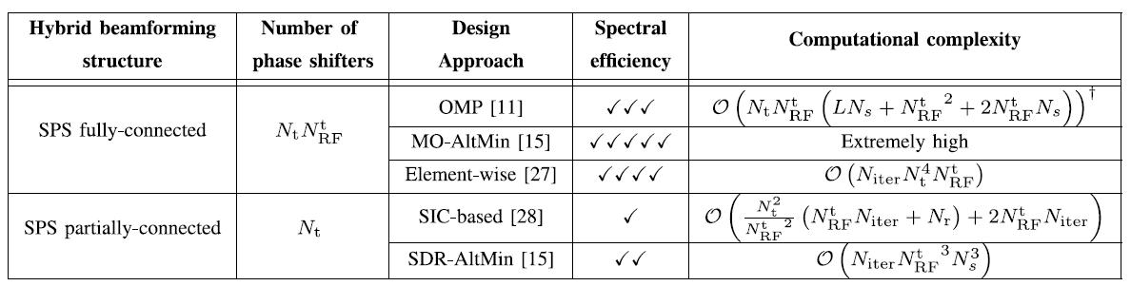
Hybrid precoding mmWave MIMO
Existing joint hybrid precoding designs
  manifold optimization, matrix decomposition, and so on
  Minimize the Euclidean distance between the hybrid precoder and the optimal fully digital precoder
High complexity
Extremely high complexity is difficult to achieve in practice!
J. Zhang, X. Yu and K. B. Letaief, "Hybrid Beamforming for 5G and Beyond Millimeter-Wave Systems: A Holistic View," IEEE Open J. Commun. Soc., vol. 1, pp. 77-91, Dec. 2020,
Notes:
The existing hybrid beamforming could obtain the near-optimal performance by optimizing the hybrid precoders to approach the performance of the fully digital precoding. In existing works , the manifold optimization, Barzilai-Borwein gradient, matrix decomposition, so on are utilized to minimize the Euclidean distance between the hybrid precoder and the fully digital precoder. However, the optimization algorithms mentioned above have high computational complexity. The Extremely high complexity is difficult to achieve in practice.

Slide 7
Contents
1
Technical background
2
Proposed solution
3
Simulation results
4
Conclusions
Notes:
To tackle this problem, we consider the use low complexity deep learning based method to realize low complexity and high performance of hybrid precoding scheme.

Slide 8
System model
System model
  Massive MIMO: antenna BS and antenna user
    Analog beamformer , , digital precoder
  Multi-path channel:
    number of path , path gain , path delay
    direction vector:
    spatial direction ,angle of departure
O. E. Ayach, S. Rajagopal, S. Abu-Surra, Z. Pi, and R. W. Heath, “Spatially sparse precoding in millimeter wave MIMO systems,” IEEE Trans. Wireless Commun., vol. 13, no. 3, pp. 1499–1513, Mar. 2014.
Notes:
Firstly, we introduce the system model. We consider mmWave massive MIMO systems. The BS equips N_{t} antenna serving a N_{r} antenna user. Then, considering hybrid precoding structure at the BS, the received signals at the user y can be denoted as the equation, where matrix A is analog beamformer, which is usually realized by analog PSs, each of elements of A has constant amplitude, matrix D is the digital precoder, H is the channel between user and BS.
For the channel, we utilize the widely used ray-based channel model, where H is a combination of multiple paths, vector a_{t} and a_{r} are steering vectors at the BS side and the user side. Specifically, the spatial direction of the l-th path \theta_{l} can be denoted as this equation. For simplification, we utilize psi_{l} located between -1 and 1 to denote the physical direction, which is the sin value of the angle of departure.

Slide 9
Hybrid precoding
Analog beamformer
  Analog beamformer generate beams towards the channel physical directions
  Consider , generate a beam on at
  Array gain of on at frequency
Digital beamformer
  Consider zero forcing (ZF) beamformer to eliminate inter-user interference
Notes:
For traditional hybrid precoding, analog beamformer usually generates beams towards the channel physical directions to capture the spatial gain of massive MIMO channel. Without losing generality, we consider the l-th column of analog beamformer A, f_{l}, which is utilized to generate a beam towards psi_{l}. Then, f_{l} can de denoted as follow, which is equal to the steering vector on \psi_{l}. Denote the array gain of f_{l} on the physical direction psi_{l} as a function \eta. We can notice that the f_{l} can achieve the array gain 1 on \psi_{l}.
For the digital beamformer, we consider the widely used Zero Forcing beamformer to eliminate the inter-user interference in digital domain. The ZF beamformer could be realized by solving the pseudo-inverse of the effective channel and then normalizing. As the result, the receiver signals can be regraded as the transmitted signal s adding the noise. However, due to the coupling of the digital beamformer and analog beamformer, the result of the analog precoding matrix A will impact the achievable performance after digital beamformer. The existing optimization methods to solve analog A with high complexity are difficult to achieve in practice.

Slide 10
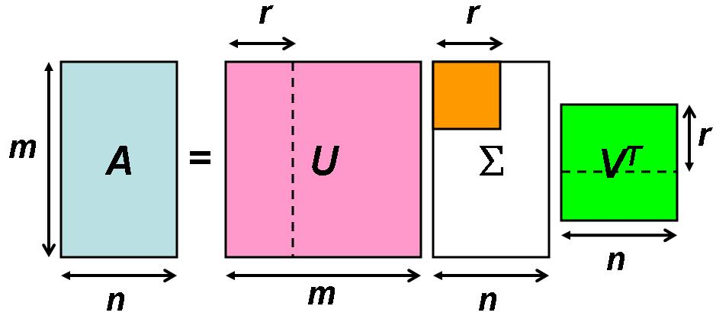
Overview
Existing low complexity deep learning methods
  Supervised learning: using SVD to obtain the label^{[1]}
  Unsupervised learning: training with the goal of maximization sum-rate^{[2]}
  Reinforcement learning: optimize the strategy function, expect to obtain the maximum sum-rate/minimum BER^{[3]}
Deep neural network
Label obtained by SVD
Unsupervised
learning
Supervised
learning
maximization sum-rate
Deep neural network
[1] T. Peken, S. Adiga, R. Tandon, and T. Bose, “Deep learning for SVD and hybrid beamforming,” IEEE Trans. Wireless Commun., vol. 19, no. 10, pp. 6621-6642, Oct. 2020.
[2] H. Huang, W. Xia, J. Xiong, J. Yang, G. Zheng, and X. Zhu, “Unsupervised learning-based fast beamforming design for downlink MIMO,” IEEE Access, vol. 7, pp. 7599–7605, 2019.
[3] Q. Wang and K. Feng, “Precodernet: Hybrid beamforming for millimeter wave systems using deep reinforcement learning,” arXiv preprint arXiv:1907.13266, Jul. 2019.
Notes:
To reduce the complexity of the hybrid precoding designs, several deep learning (DL) based hybrid precoding methods have been recently proposed, which could be generally divided into the supervised learning based method, the unsupervised learning based method, and reinforcement learning based method. For supervised learning based method, the hybrid precoders are labeled according to the classical singular value decomposition (SVD), which requires a lot of computation resources to calculate the SVD. Unlike supervised learning, the unsupervised learning based method learns the precoder without labeled samples. In this case, the unsupervised learning methods directly take sum-rate as loss function to train the DL model. However, the existing works just use simple fully-connected (FC) neural networks, resulting in the limited performance. At last, the reinforcement learning based method aims to optimize the strategy function to obtain the larger reward, however, the training is different to converge.

Slide 11
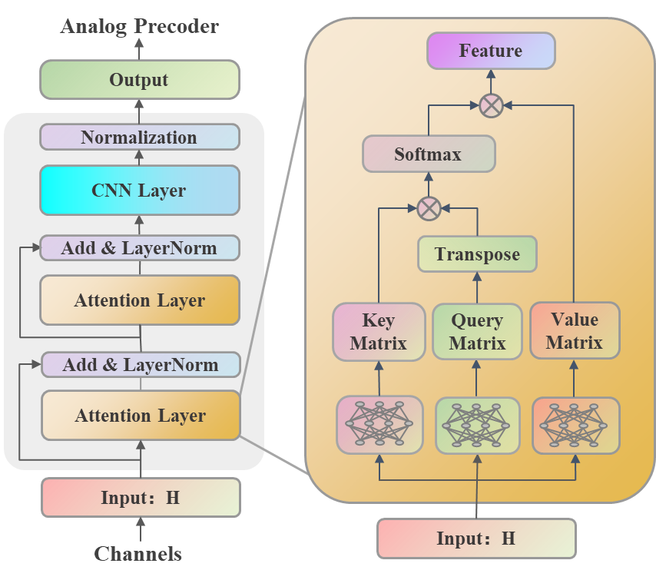


Overview
Our solution
  Attention layer: identify the features of inter-user interferences
  CNN layer: analog precoder design to maximize the achievable sum-rate
inter-user interference
Notes:
We can notice the reason for limited performance of unsupervised learning is that the simple designed neural network, which is difficult to calculate the inter-user interferences. Therefore, inspired by the recently developed attention mechanism, we propose an attention-based hybrid precoding to identify the features of inter-user interferences. The figure shows the basic structure of the proposed attention-based neural network model. Specifically, the attention layer is designed to identify the features of inter-user interferences. Then, a low-complexity CNN layer is utilized to learn the analog precoder according to the features of inter-user interferences.

Slide 12
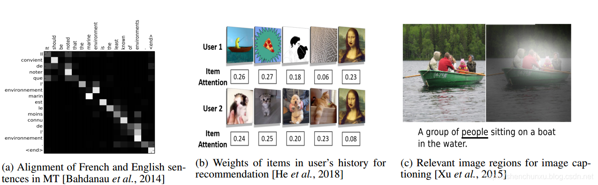
Attention-based model
Attention mechanism
  Redistributes the resources according to the importance
  Intuitive explanation: Our visual system tends to focus on areas that assists in judgment, and ignores irrelevant areas
  Interpretability: Visualize a set of input and output attention weights
Notes:
Firstly, we will give a simple introduction of the attention mechanism. The attention mechanism could be regarded as a resource allocation mechanism, which distributes more resources to more important components. Intuitively, the attention mechanism can be explained by the human visual mechanism. The human visual systems obtain the key areas after scanning the visual field, and then the visual systems pay more attention to the stimuli information from these more important areas, while restraining the information from less important areas. By distributing different resources to different areas, the human visual system is able to greatly reduce the complexity and improves the accuracy of visual signal processing. These are some application of attention in machine translation, user recommendation, and caption for image, which provide a good interpretability by visualizing the attention weights.

Slide 13
Attention-based model
Attention layer
  Analyze the inter-user interferences based on the attention mechanism to design better beams
  single antenna users channel matrix
  Query matrix , key matrix , value matrix
  Attention matrix
Query matrix
Output matrix
softmax( )
Input channel matrix
Key matrix
Attention matrix
Value matrix
Notes:
Specifically, for our attention layer, the K single antenna users channel matrix is linearly transformed by three different one-layer FC neural network. After that, three feature matrices, Query matrix, key matrix, and value matrix is obtained. Then, the query matrix multiplies the transpose of the key matrix and the result is operated by softmax operation. Since the softmax can obtain the normalized weights, the attention weights for each user to other user can be acquired. Finally, the output of the attention layer is calculated according to the product between the attention matrix and value matrix V.

Slide 14
Attention-based model
CNN layer
  user; BS Nt antennas; real and image dual channels; F extended channels
  Loss function: the negative of the sum-rate
High-level
information synthesis
Low-level local perception
Analog precoding matrix
Attention
output
+b1
+b1
+b2
+b2
Notes:
Then, based on the features extracted by attention layer, the following CNN layer is designed to learn the analog beamformer. As shown in the figure below, for Nt antennas BS serving K user system, the real and imaginary dual input channel are expanded into F-dimension features for low-level local perception. Further, convolutional kernels of different lengths are used to extract features of different scales, and the final analog precoding matrix is obtained by synthesis at the high level. The digital part adopts ZF beamformer, and the negative of sum rate is used as the loss function to jointly optimize the whole network.

Slide 15
Contents
1
Technical background
2
Proposed solution
3
Simulation results
4
Conclusions
Notes:
Next, we will provide simulation results to verify the advantages of our method.

Slide 16
Simulation parameters
System parameters
  MIMO configuration:
  Carrier frequency:
Channel parameters for each user
  Channel model: Saleh-Valenzuela model
  Antenna array: ULA with antenna spacing
  Number of resolvable paths:
  Path delay: and
  Path gain:
  Physical direction:
Algorithm parameter
  Feature dimension: ;
  Extended feature:
Notes:
The detailed simulation parameters are listed in this slide. We consider a mmWave MIMO system, where the BS equips a 64 antenna array and 16 RF chains to serve 16 single-antenna users. The central-carrier frequency is 28GHz. The multi-path channel model is adopted, where we assume that the number of paths is 3.

Slide 17
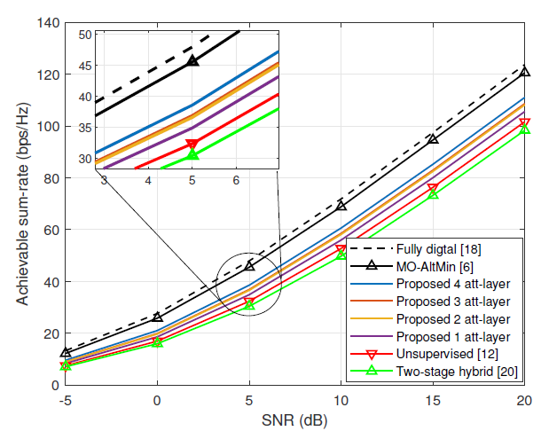
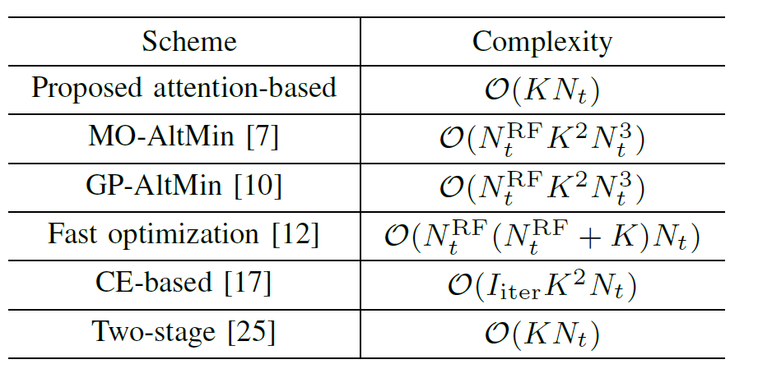
Sum-rate performance against SNR
Observations
  Attention-based method outperforms the pure unsupervised learning
  More attention layer means better sum-rate performance
  Mo-AltMin could achieve best performance while highest complexity
[7]
[25]
Notes:
This slide shows the sum-rate performance against SNR. We can notice that, compared with pure unsupervised method, the attention-based method could realize better performance, and more attention layer could realize larger improvement performance. The optimization method from reference [7] achieve best performance while means the highest complexity. Next, we show the Interpretability of the attention-based method.

Slide 18

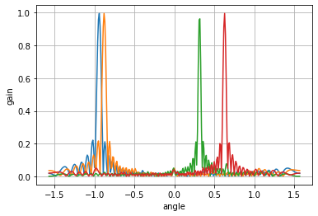
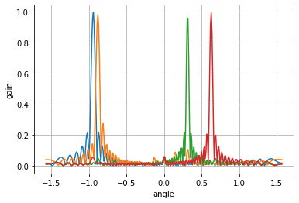
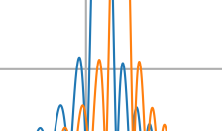
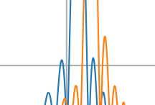
Special case
Observations
  User number K=4, path number L=1, path gain
  AoDs for 4 users:
  User 2’s sidelobe is suppressed, weakening the interference with user 1 when we use one attention layer.
Attention matrix：
User 2's
interference
with user 1
User 1's
interference
with user 2
User 2's
interference
with user 1
User 1's
interference
with user 2
(a) no attention layer
(b) one attention layer
Notes:
We show the how the interference is weaken by attention based hybrid precoding. For a special case, four users served by a BS, all have only one path and each path gain is set as 1. The AoDs for these four user are -0.3pi, -0.28pi, 0.1pi, amd 0.2pi, respectively. From the left figure, we can notice that the user 2’s sidelobe has a significant interference with user 1, since the closed AoD. After adding one attention layer, user 2's interference with user 1 is reduced. According to attention matrix, we found that the row 2 column 1 element is small, and the third column element value of 0.86778 is bigger, which shows that when designing analog beamformer for user 2, less attention is paied to user 1 whose interference is serious and try to shift the beam to the user 3 whose interference is not serious.

Slide 19
Contents
1
Technical background
2
Proposed solution
3
Simulation results
4
Conclusions
Notes:
Finally, we will make a brief summary of this talk.

Slide 20
Summary and conclusions
Attention-based hybrid precoding
  Attention layer: identify the features of inter-user interferences
  CNN layer: analog precoder design to maximize the achievable sum-rate
  Low complexity
Performance
  Achieve higher sum-rate than pure unsupervised learning method
Notes:
In this talk, to improve the performance of the deep learning based hybrid precoding. Inspired by the attention mechanism, we proposed an attention-based hybrid precoding scheme. The neural network model contains two part, attention layer and CNN layer. The attention layer is to identify the interferences among users, so that the interference features can be obtained. The CNN layer is to learn the analog precoder according to interference features. Simulation results verify the better sum-rate performance of the proposed attention-based hybrid precoding scheme compared with the classical algorithm.

Slide 21

itw2021.org
Kanazawa, Japan, October 17-21
Thank you !
Contact information
  Hao Jiang, Tsinghua University
  Email: jiang-h18@mails.tsinghua.edu.cn
  Website: http://oa.ee.tsinghua.edu.cn/dailinglong/
Notes:
That’s all. Thanks for your attention.

